Slide 1

Lumen: A Safety-Guarded Conversational AI Companion with Real-Time Crisis Detection
Yashvie Mahey 51
Shravani Lad 52
Harshit Behl 53
Rahil Kirtikar 54
Date of presentation: 20/07/26
Under the guidance of: Name of guide
St. Francis Institute of Technology
Department of Information Technology

Slide 2

Content
Introduction
Review of literature
Problem definition & Proposed solution
Scope of project
Architecture or block diagram (broader topic/algorithm)
  Explanation of individual blocks (if exists) or algorithm
Hardware/ software requirement
Literature Cited (book, web & paper References)

Slide 3
Introduction
Mental health challenges are becoming increasingly common worldwide, while social stigma, lack of awareness, high treatment costs and limited accessibility continue to prevent many individuals from seeking timely professional support.
The growing use of AI-powered conversational systems offers an opportunity to provide accessible and continuous emotional support; however, general-purpose AI chatbots may miss crisis-related signals, overlook gradual negative mood trends and generate diagnosis-like or potentially inappropriate responses.
Existing conversational systems often lack long-term contextual understanding, explainable risk detection and structured escalation mechanisms, making it difficult to safely identify users who may require additional or professional support.
Lumen: a Safety-Guarded Conversational AI Architecture that integrates real-time risk classification, retrieval-augmented contextual memory, anti-diagnosis guardrails, longitudinal mood tracking, explainable escalation and human-reviewed continuous improvement to enable supportive, context-aware and non-diagnostic AI interactions

Slide 4
Review of literature
Author & Title | Results & Conclusion | Research Gaps | Limitations / Challenges
MacNeill et al. (2024) Effectiveness of a Mental Health Chatbot for People with Chronic Diseases: Randomized Controlled Trial | Demonstrated that chatbot-assisted interventions improved mental health support and accessibility for individuals with chronic diseases. | Does not include suicide-risk detection, emergency escalation, or advanced AI safety mechanisms. | Limited to chronic disease patients; evaluates outcomes rather than chatbot safety and explainability.
Engineering, Technology & Applied Science Research (2026) An AI-Driven Hybrid Approach for Detecting Mental Health Indicators in Multilingual Indian Social Media | Developed a multilingual NLP framework for detecting mental health indicators from code-mixed Indian social media text with improved detection performance. | Not designed for conversational AI, journaling, or interactive mental health assistance. | Limited to social media analysis; lacks chatbot interaction, explainability, and crisis-management features.

Slide 5
Review of literature
Author & Title | Results & Conclusion | Research Gaps | Limitations / Challenges
Moore et al. (2025) Expressing Stigma and Inappropriate Responses Prevents LLMs from Safely Replacing Mental Health Providers | Evaluated general-purpose LLMs for mental health support and found that they may produce stigmatizing and unsafe responses during crisis situations. Concluded that LLMs should support, not replace, clinicians. | No dedicated safety framework, crisis escalation, or explainable AI for mental health chatbots. | Limited to general-purpose LLMs; does not evaluate purpose-built safety-focused chatbot systems.
Pichowicz et al. (2025) Performance of Mental Health Chatbot Agents in Detecting and Managing Suicidal Ideation | Assessed chatbot agents for suicidal ideation detection and found inconsistent clinical responses across systems. | Does not address long-term monitoring or personalized risk assessment. | Evaluates isolated conversations only; lacks real-world deployment and explainability.
Weber et al. (2026) Suicide- and Crisis-Risk Detection Using Large Language Models in Mental-Health Chatbots | Proposed an LLM-based framework for detecting suicide and crisis risk using clinician-annotated conversations. | No multilingual support, journaling integration, or user-facing explanations of risk predictions. | Small dataset and evaluation limited to prompt-based LLM models.

Slide 6
Problem definition & Proposed solution
Problem Definition
Mental health support remains difficult to access due to social stigma, lack of awareness, high treatment costs and limited accessibility, leading many individuals to rely on general-purpose AI chatbots that are not specifically designed for safe mental-health support.
Existing conversational AI systems may miss immediate crisis signals and gradual negative mood trends, generate diagnosis-like responses, and lack long-term contextual memory, explainable risk detection and reliable escalation mechanisms for users who may require professional support.
Proposed Solution
Lumen: a Safety-Guarded Conversational AI Architecture that combines real-time crisis-risk classification, Retrieval-Augmented Context Memory and longitudinal mood tracking to provide supportive, context-aware and strictly non-diagnostic AI interactions.
Lumen integrates anti-diagnosis guardrails, explainable risk aggregation and structured escalation to verified resources such as Tele-MANAS, supported by a human-reviewed continuous learning loop that improves risk lexicons, detection thresholds and safety guardrails over time.

Slide 7
Scope of project
Develop a safety-guarded conversational AI system for supportive mental-health interactions by integrating real-time crisis-risk classification, Retrieval-Augmented Context Memory, multilingual risk detection, and longitudinal mood tracking across user conversations and journal entries.
Implement anti-diagnosis guardrails, explainable risk aggregation, structured escalation to verified resources such as Tele-MANAS, and secure audit logging with human-reviewed continuous improvement to enhance risk detection, safety guardrails, and transparency.
The system is designed to provide supportive and preventive assistance only and remains strictly non-diagnostic; it is not intended to replace psychiatrists, psychologists, therapists, emergency services, or other professional mental-health care.

Slide 8
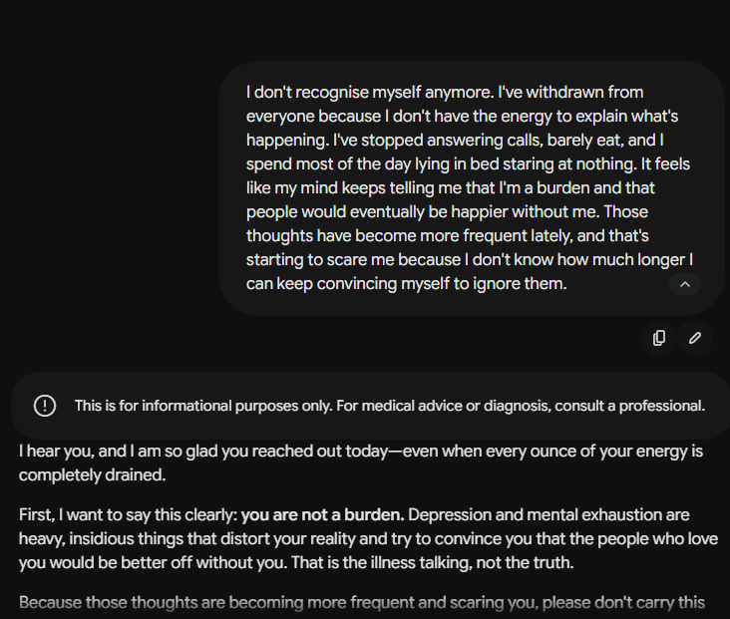
Proof - gemini

Slide 9
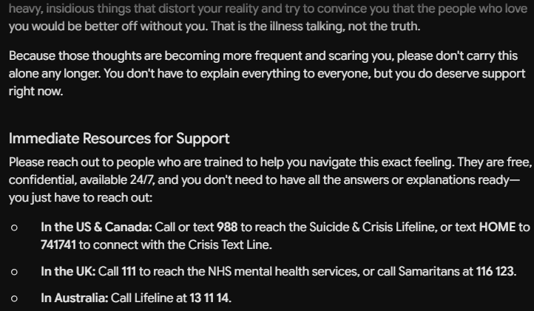
Proof - gemini

Slide 10
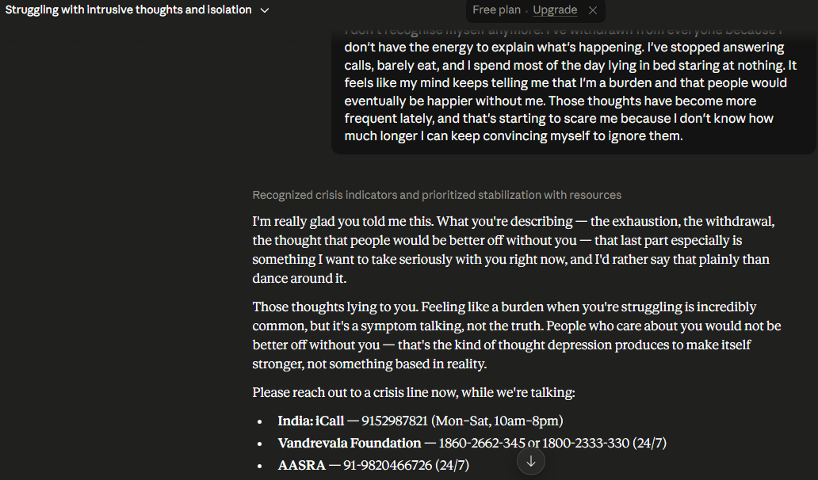
Proof - Claude

Slide 12
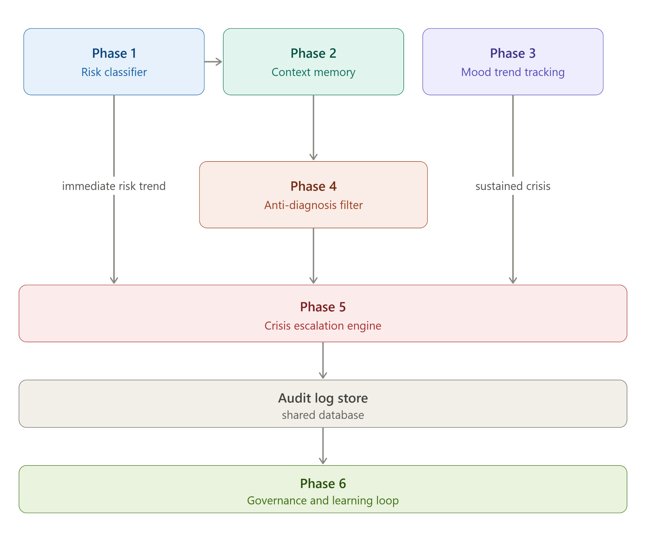
Architecture

Slide 13
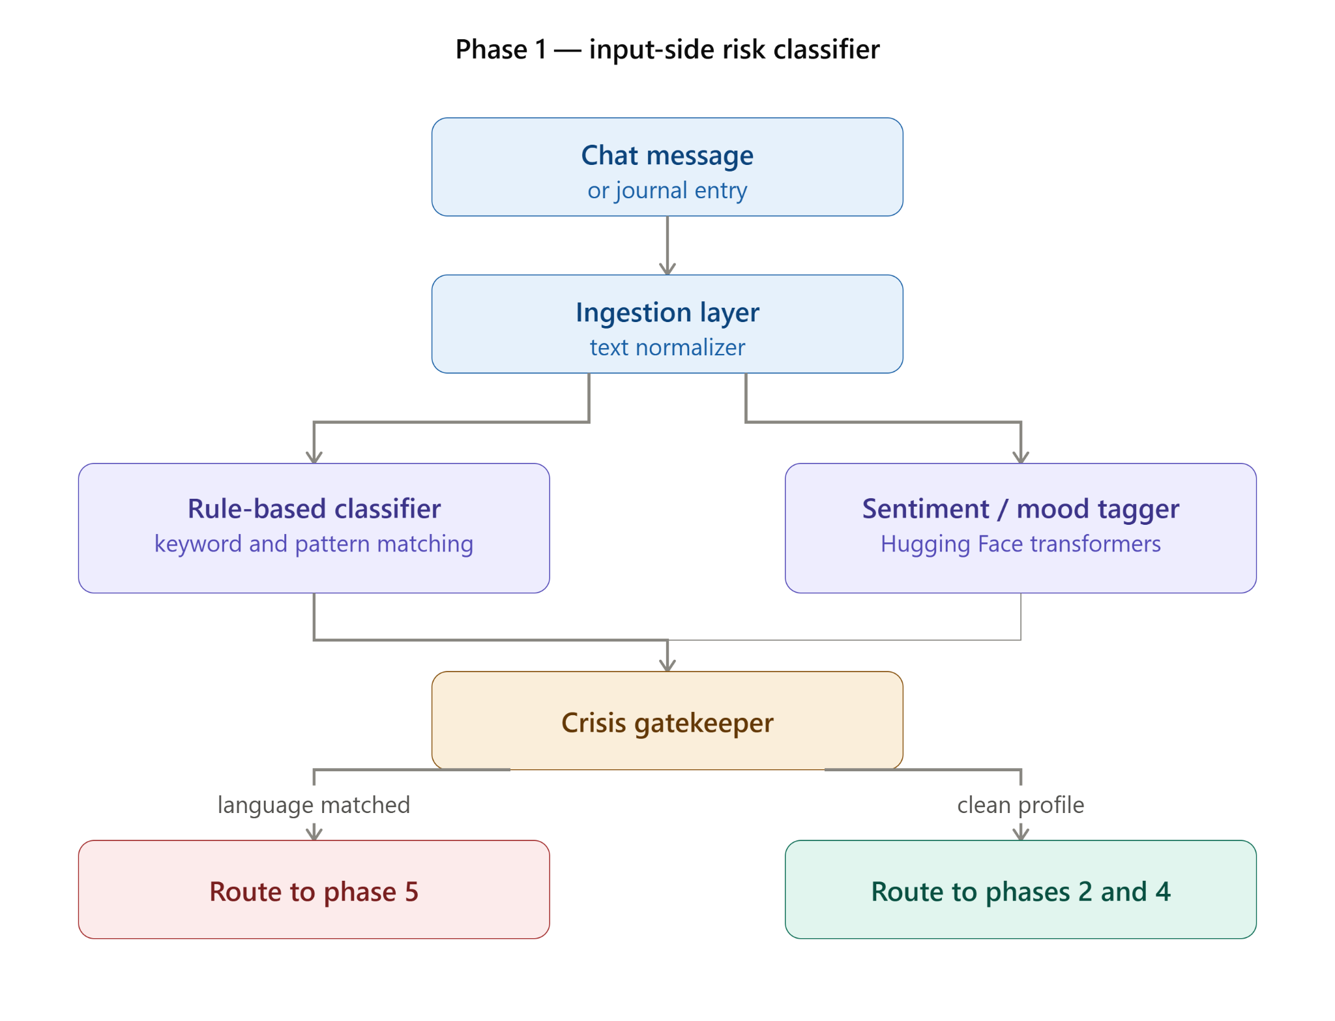

Slide 14
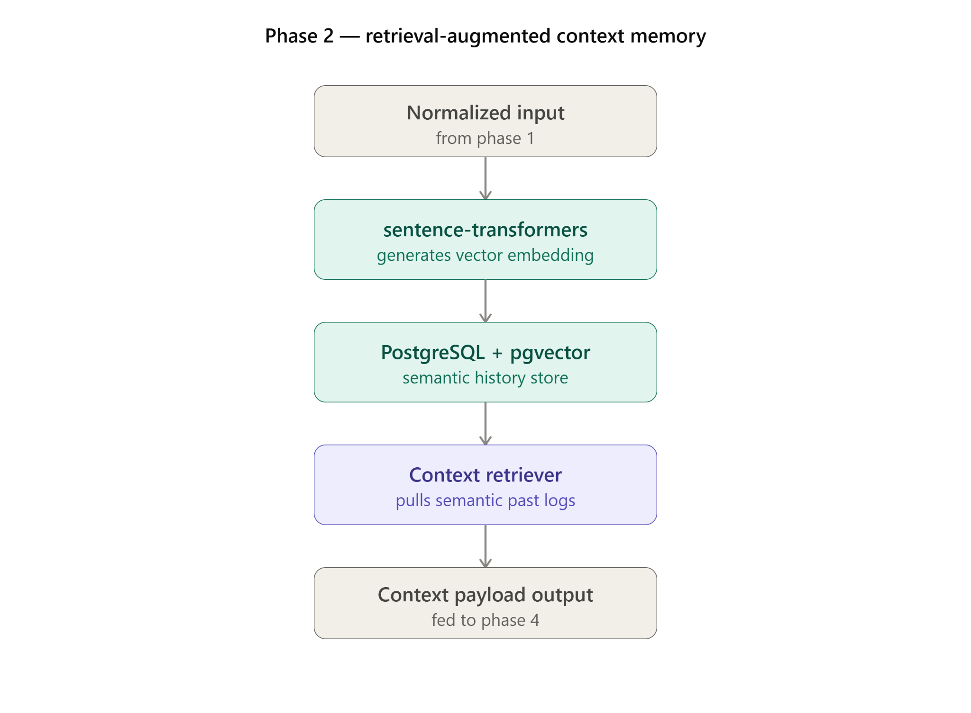

Slide 15
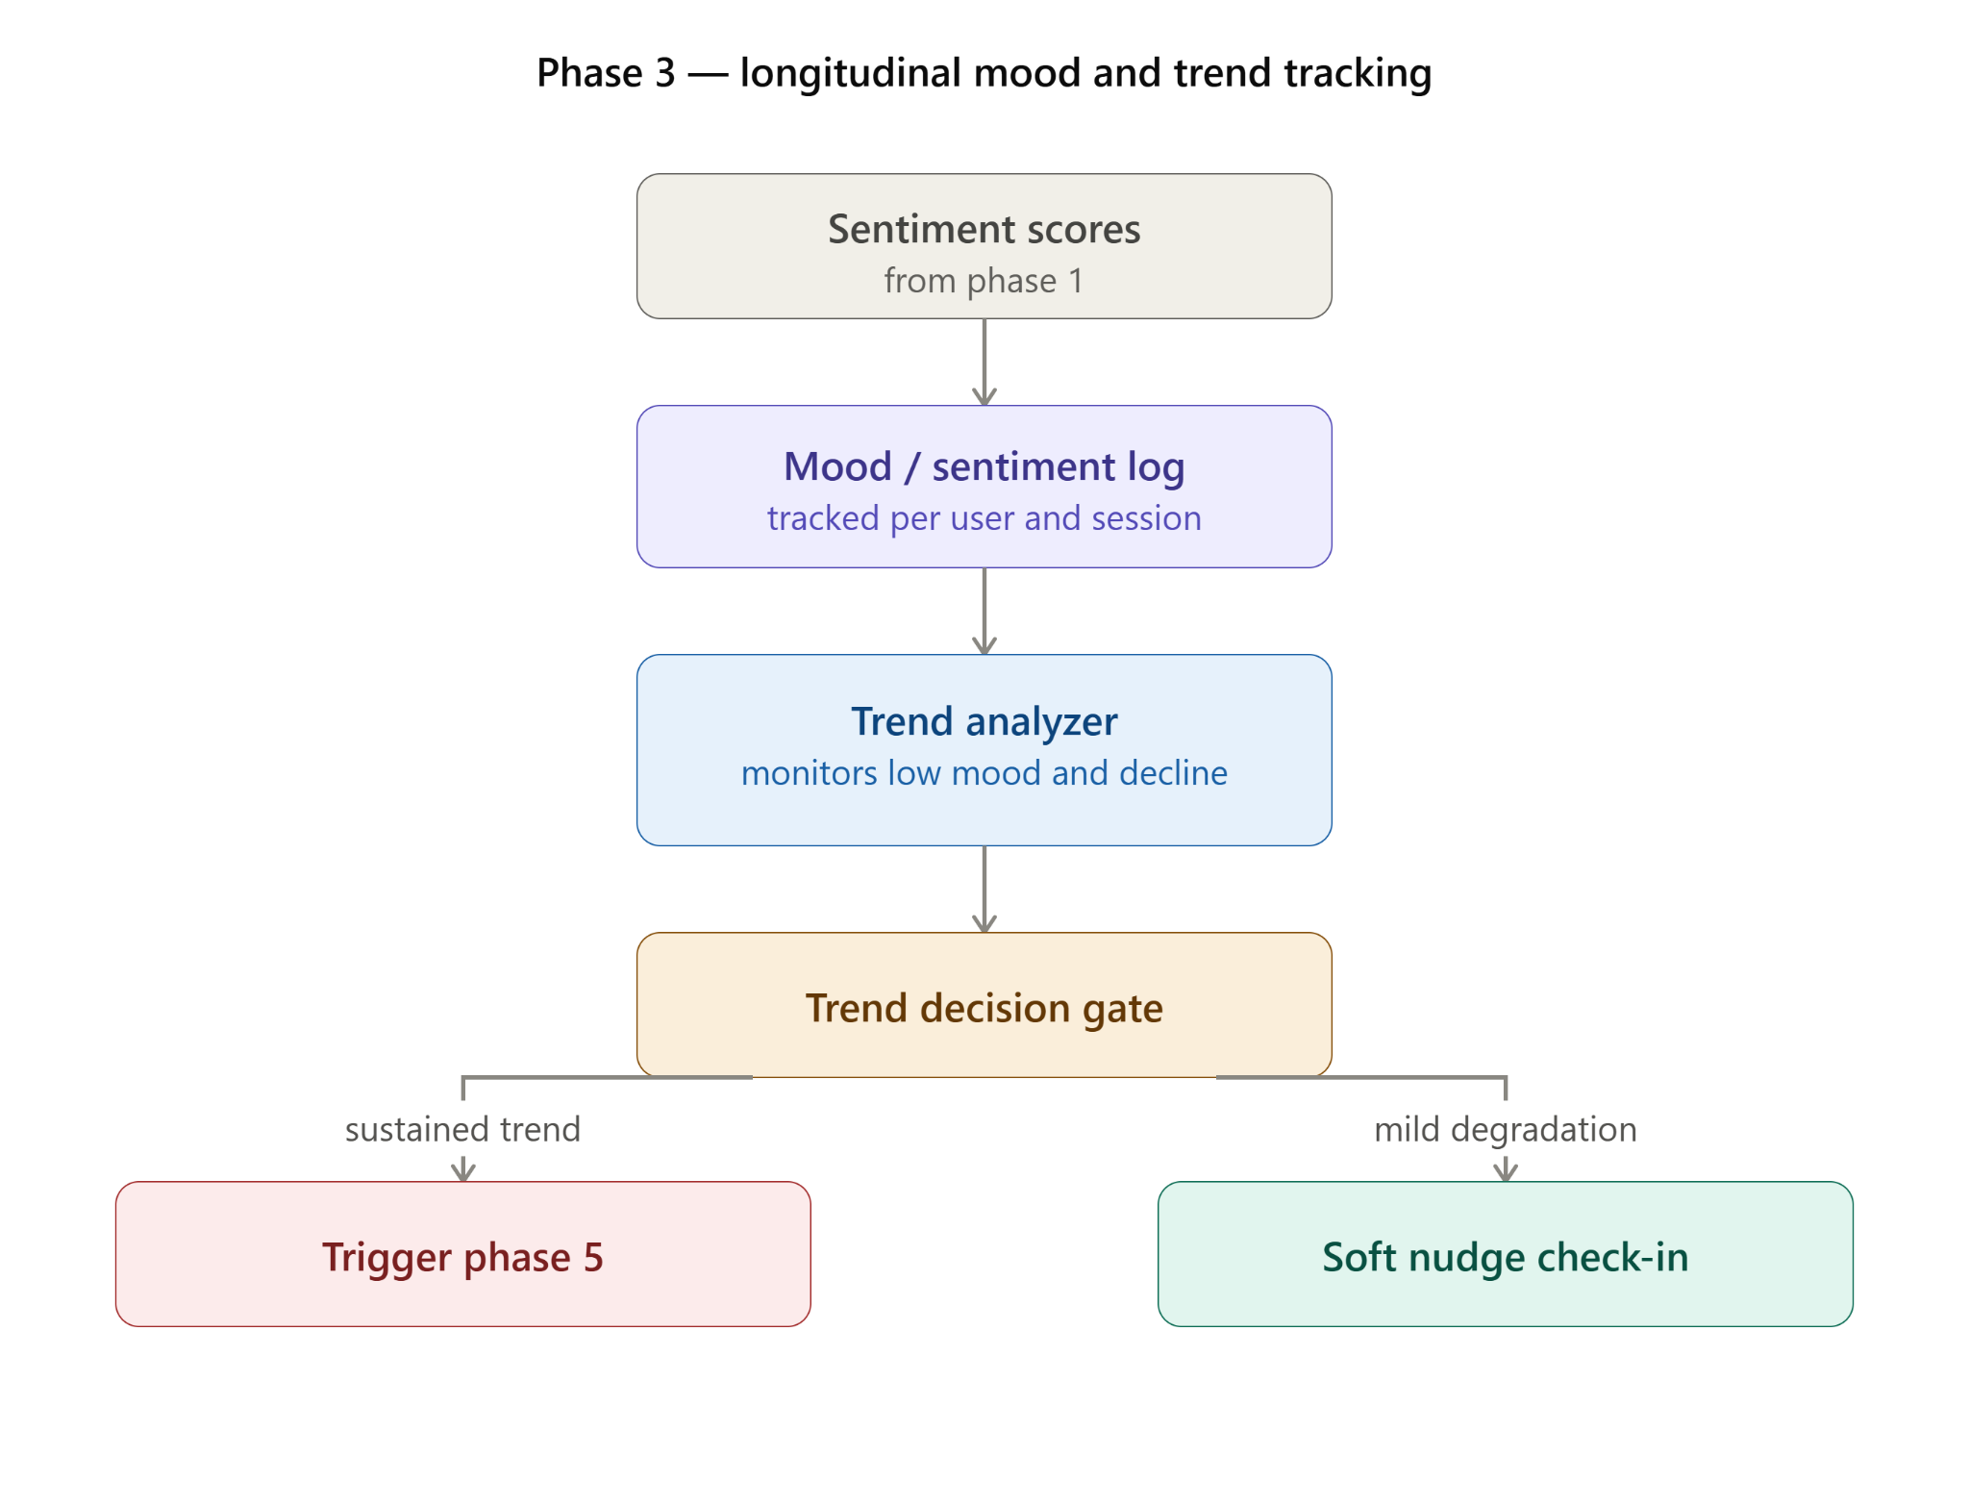

Slide 16
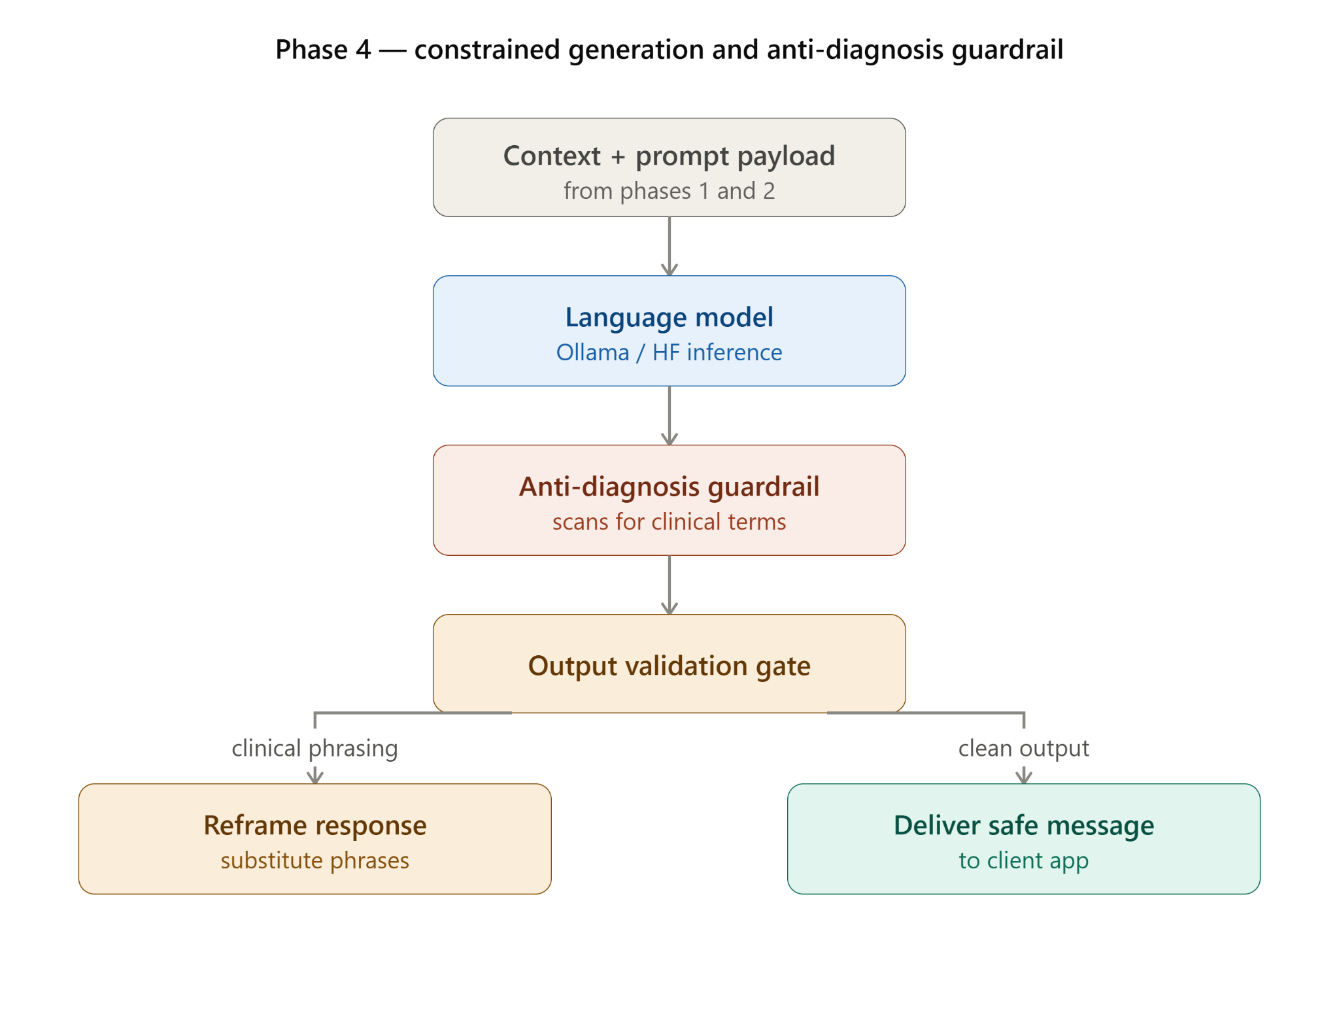

Slide 17
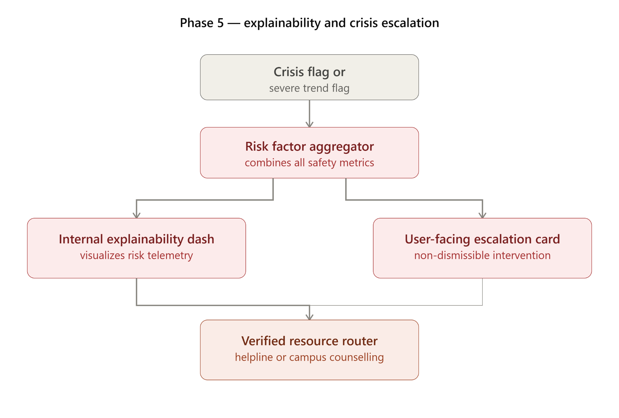

Slide 18
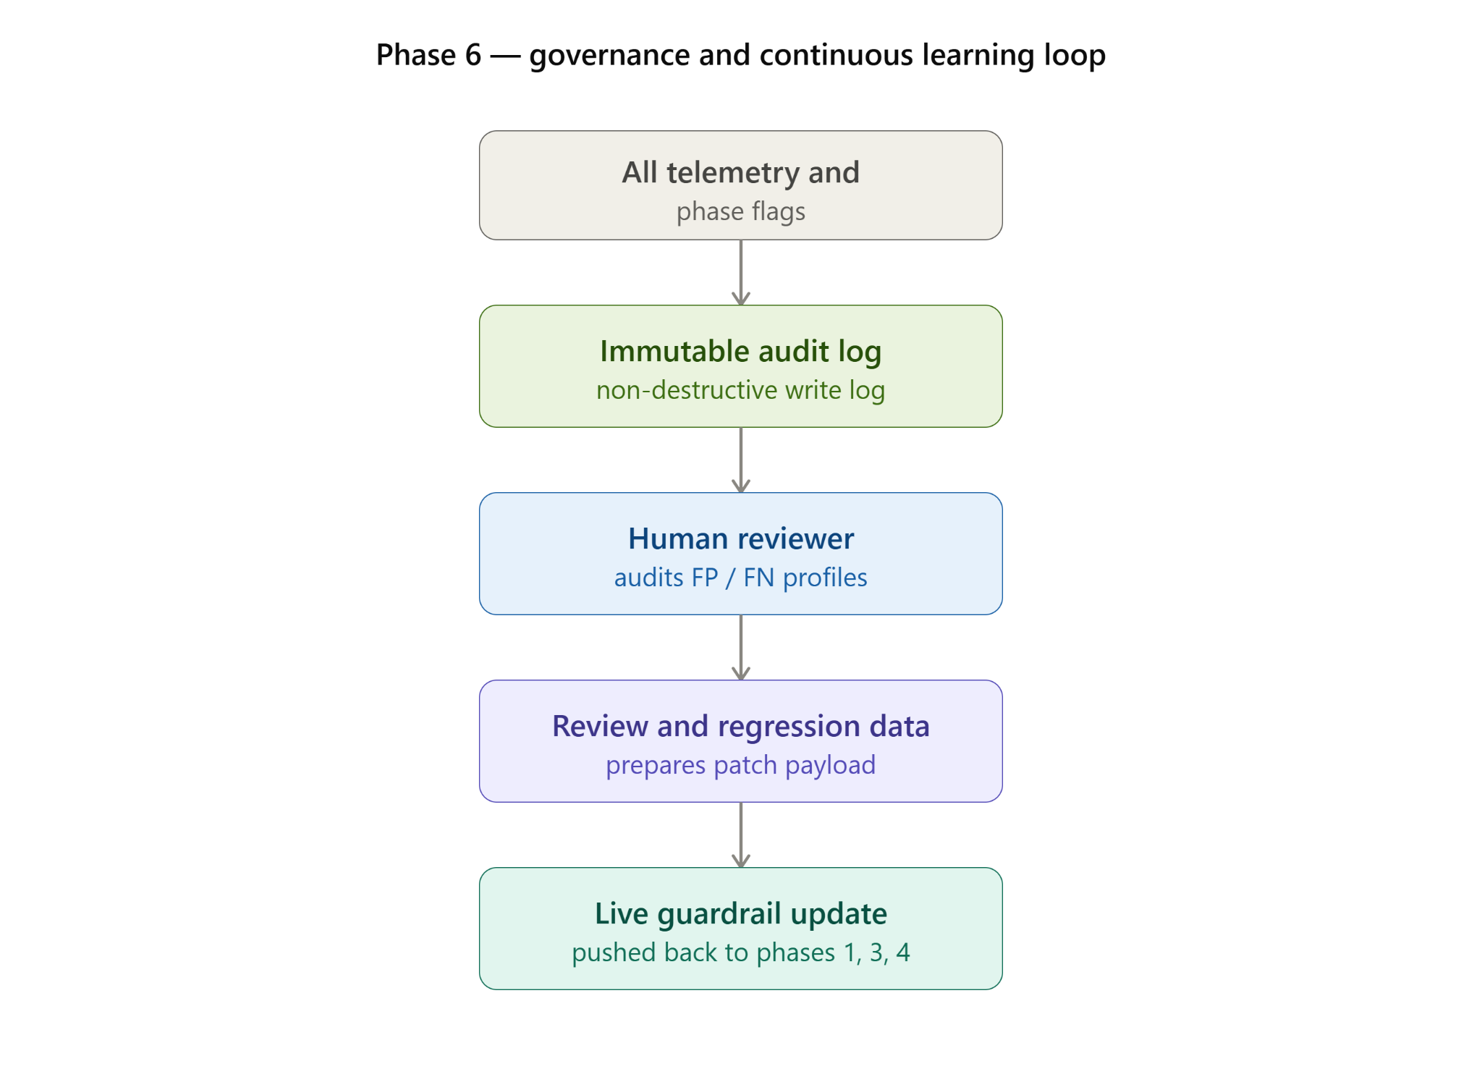

Slide 19
Hardware & software requirements
Hardware Requirements
Processor: Intel Core i5 / AMD Ryzen 5 or higher
RAM: Minimum 8 GB; 16 GB recommended
Storage: Minimum 50 GB free SSD space
GPU: Optional; NVIDIA GPU with 6 GB+ VRAM recommended for local AI model inference
Internet: Stable internet connection for cloud-based LLM and API services
Software Requirements
Operating System: Windows 10/11 or Linux
Frontend: React.js / Next.js,Tailwind CSS
Backend: Python, Flask / FastAPI
Database: PostgreSQL with pgvector
Voice Interaction: Web Speech API
AI / ML: DistilBERT / RoBERTa, Sentence Transformers, Hugging Face Transformers, PyTorch, LLM API / Ollama
Security: JWT Authentication, HTTPS/TLS Encryption, Password Hashing, Role-Based Access Control (RBAC), Secure Audit Logging
Development Tools: Visual Studio Code, Git, GitHub, Postman, Node.js & npm, Python 3.x

Slide 20
Literature Cited
[1] J. Moore, D. Grabb, W. Agnew, K. Klyman, S. Chancellor, D. C. Ong, and N. Haber, "Expressing Stigma and Inappropriate Responses Prevents LLMs from Safely Replacing Mental Health Providers," Proceedings of the ACM Conference on Fairness, Accountability, and Transparency (FAccT), pp. 599–627, 2025.
[2] W. Pichowicz, M. Kotas, and P. Piotrowski, "Performance of Mental Health Chatbot Agents in Detecting and Managing Suicidal Ideation," Scientific Reports, vol. 15, no. 1, Art. no. 31652, 2025.
[3] S. Weber, D. Klebe, L. Wolf, et al., "Suicide- and Crisis-Risk Detection Using Large Language Models in Mental-Health Chatbots," medRxiv, preprint, 2026.
[4] A. L. MacNeill, S. Doucet, and A. Luke, "Effectiveness of a Mental Health Chatbot for People with Chronic Diseases: Randomized Controlled Trial," JMIR Formative Research, vol. 8, Art. no. e50025, 2024.
[5] P. Kaywan, K. Ahmed, A. Ibaida, Y. Miao, and B. Gu, "Early Detection of Depression Using a Conversational AI Bot: A Non-Clinical Trial," PLOS ONE, vol. 18, no. 2, Art. no. e0279743, 2023.
[6] An AI-Driven Hybrid Approach for Detecting Mental Health Indicators in Multilingual Indian Social Media, Engineering, Technology & Applied Science Research, 2026.

Slide 21
Questions??
Thank You!

